Slide 1

Cell 1: 160x123
Cell 4: 160x123
8 cells
Size: 160x990

Slide 2
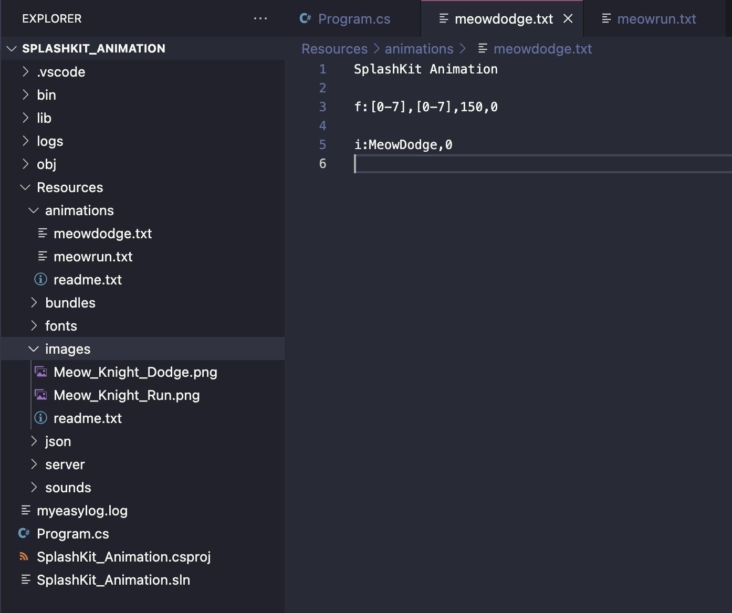
meowdodge.txt is saved in aniamtions
frames are declared with f:
the cell of the bitmap to draw this can be a range defined using [0-7]
meowdodge.txt starts with
“SplashKit Animation”
duration of a cells (before moving to the next one)

Slide 3
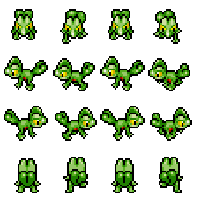
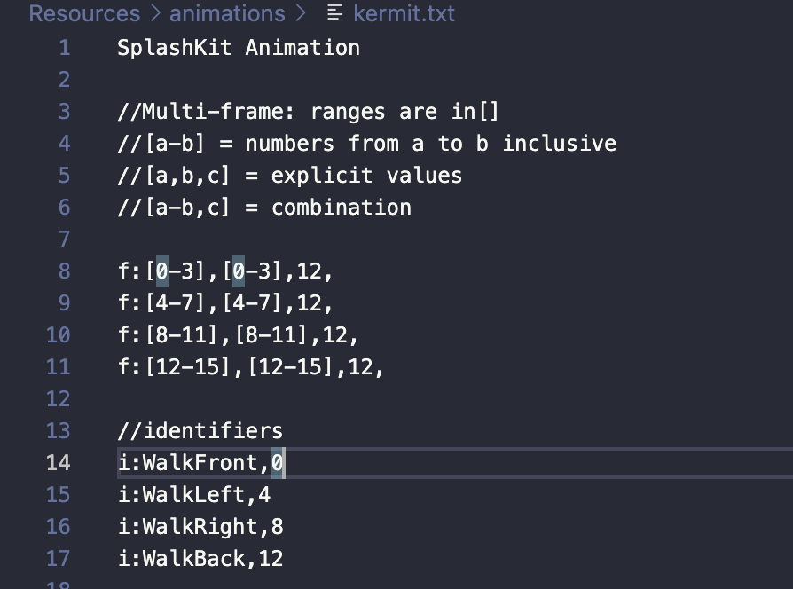
lizard.png
size 228 × 224
lizard.SetCellDetails(57, 56, 4, 4, 16);
4 columns x 4 rows

